Slide 1
PUTTING KNOWLEDGE TO WORK
STRATEGICALLY MOVING SOCIAL PROTECTION UP THE AFRICAN POLICY AGENDA
Social Protection Seminar
Min. of Foreign Affairs
23/6/16

Slide 2
PRESENTATION OUTLINE
CONTEMPORARY AFRICAN CONTEXT FOR DISCUSSING SOCIAL PROTECTION
OUR CURRENT KNOWLEDGE ON SOCIAL PROTECTION
TURNING RESEARCH EVIDENCE ON SOCIAL PROTECTION INTO POLICY ACTION THROUGH UTAFITI SERA IN KENYA
2
2

Slide 3
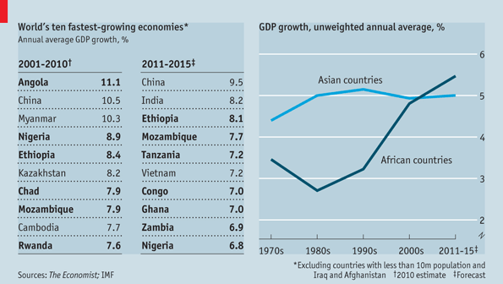
CURRENT CONTEXT: AFRICA GROWTH NARRATIVE

Slide 4
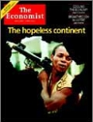
CURRENT CONTEXT IS DIFFERENT 15 YEARS AGO
1980-90s Africa Growth rate averaged about 2.5%
High levels of Poverty
Civil Wars
High Dependency on Foreign Aid
= African ‘Basket Case’
May 13th, 2000

Slide 5
CONTEXT: AFRICA RISING
Can African Lions emulate Asian Tigers?
‘African Lions’ Chase ‘Asian Tigers’
Why has Asia done so well with growth (reducing poverty and vulnerability) and Africa not so well?
Key success factor: Policy Decisions
5

Slide 6
AFRICA RISING BUT……
Wage employment remains disappointedly low!
GDP Growth about 6% between 2004-2012 but Labour force employed in wage-paying jobs increased by only 0.4%.
Growth not inclusive:
Employment creation sectors (agriculture and manufacturing not growing)
Poverty not reducing substantially
Growing income, geographical and gender Inequality
Service Sector becoming the leading sector and where vulnerable employment is high (informal sector).
Bottom line: Promoting inclusive growth means employment creation, rising household incomes, provision of social protection and improving and power relationships
6
6

Slide 7
SOCIAL PROTECTION POLICY & PROGRAMS
For the past decade African govt’s. DP, multilateral agencies, African Union have placed high priority on SP as an instrument for reducing poverty, vulnerability, unemployment and underemployment in Africa (AU, 2004; 2006; 2010; DFID, 2005; UNICEF 2011; 2008; EU, 2010).
Many African countries have introduced various social protection programmes.
Protective services “come to the rescue” of vulnerable people in crisis: food aid, cash transfers to people with disability and old age)
Promotive services: “improve livelihoods” (income-generating activities, skills training)
Preventive services: Health insurance; free Maternal health
Transformative services: “changing social structures & power relations” that lead to inequality: Affirmative action, minimum wage rules, etc
7
7

Slide 8
Coverage of safety net programs has been increasing…
World Bank (2015) State of Social Safety Nets.

Slide 9
SOCIAL ASSISTANCE PROGRAMMES
COUNTRY | SOCIAL TRANSFER PROGRAMME | YEAR | US$PER HHs/ MONTH | FUNDERS
Ethiopia | PSNP | 2005 |  | CIDA, Dutch Govt. EC, Irish Aid, SIDA, USAID, DfID, DANIDA & WB
Ghana | LEAP | 2009 | US$12.5-25 | GoG, DFID & World Bank
Kenya | OPCT; OVC, PWSD, HSNP | 2004 | US$20-25 | Government, UNICEF, DFID
Lesotho | Child Grant Programme | 2011 | US$12-75 | Government & EU
Malawi | Social Cash Transfer | 2007 | US$13 | USAID, World Bank, GoM
Uganda | Social Assistance Grants for Empowerment | 2010 | US$8 | Government, DfID, UNICEF and Irish Aid
Zambia | Child Grant Programme | 2010 | US$12 | Government, UNICEF
Tanzania | Tanzania Social Action Fund | 2009

Slide 10
HOUSEHOLDS BENEFTING FROM SOCIAL ASSISTANCE PROGRAMMES IN KENYA
FROM 155, 000 HOUSEHOLDS IN 2012
Programs | 2013/2014 | 2014/15 | 2015/16 | 2016/17
OPCT | 164,000 | 225,000 | 310,000 | 460,000
CT-OVC | 259,000 | 255,470 | 359,000 | 509,000
PWSD-CT | 27,000 | 27,000 | 47,000 | 77,000
HSNP | 61,698 | 76,069 | 100,000 | 100,000
Total | 521,298 | 583,539 | 816,000 | 1,146,000

Slide 11
SPENDING ON SOCIAL ASSISTANCE IN AFRICA
Source: Gentillini et al, 2014

Slide 12
EXISTING KNOWLEDGE ON SOCIAL PROTECTION IN AFRICA
Existing SP programmes cover only a fraction of eligible poor and vulnerable people.
High demand by the poor & vulnerable for expanding CT coverage
Africa’s recent economic growth and future prospects provide fiscal space to expand coverage
Eg National coverage of Health insurance in Rwanda cost about 1% of GDP
From Protection to Production: evidence is emerging that giving money directly to the poor works to reduce poverty, vulnerability and inequality:
CTs have significant multiplier benefits on local economy (FAO impact assessment) .
WB 2015 report ‘income multiplier ranging US$1.34 to US$2.52 for each US$1.00.
But many African researchers and policy makers are skeptical about impact evidence
Fragmentation of social protection programmes
12
12

Slide 13
KNOWLEDGE ON EXPANSION OF SP IN AFRICA
Given existing national budgets on SP in Africa:
Making expenditures more efficient within the existing resource envelope offers only a limited opportunity to increase coverage.
Integrate existing non-state & informal mechanisms into national SP system
Need to raise the share of domestic funding for social protection
Increasing policymakers’ awareness of the links between SP and Eco. Growth to overcome concerns about dependency & redistribution vrs accumulation argument.
Continuation/Expansion of development partners’ support will be necessary although there are concerns about sustainability & interest in CTs programmes.
13
13

Slide 14
PROMOTING WAGE EMPLOYMENT & STRUCTURAL TRANSFORMATION IN AFRICA IS KEY TO INCLUSIVE DEV
Cash transfers are short run palliative measures to promote inclusive growth.
Good for vulnerable people: children, older people & People with severe disability
Long-term sustainable inclusive development will depend on support to wage employment creation in agribusiness value chain and productivity gain.
PASGR study on the political economy of SP in Africa shows that Min. of Finance are fixated on growth more than social assistance:
Uganda: “what drives growth? What is the bigger problem: unemployed youth who’re more than 50% of the population or the few elderly people?”
Policies on employment creation are seen as subsets of economic growth.
Politics and the pursuit of narrow interest of strategic actors are major blockages to employment creation potentials of agro value chain.
14
14

Slide 15
STRATEGICALLY MOVING SOCIAL PROTECTION UP THE AFRICAN POLICY AGENDA REQUIRES SOCIAL, ECONOMIC AND POLITICAL ACTION (SEPA)
To push for uptake of SP will require:
Promotion of rights-based ‘social contract’ in the national agenda (Legislation of SP).
Progressive social agenda has seldom happened without the pressure of organised groups.
Strategic alliances among different political and economic interest groups (elites and regimes, the rising middle class, economic interest group, trade unions, etc.).
Identify drivers of change and build political constituencies among different actors so as to secure policy support.
15
15

Slide 16
TURNING RESEARCH EVIDENCE INTO POLICY ACTION THROUGH UTAFITI SERA
Experience suggests that turning research evidence to policy action is likely to be successful when a dedicated and well thought mechanisms involving a community of practice is developed.
‘Utafiti Sera is ‘process’, ‘place’, ‘forum’, ‘platform’, or a ‘vehicle’ that facilitates building a community of researchers and policy actors working together to ensure that appropriate and negotiated policy actions and uptake occur either through programmes, legislations, policies or administrative and other forms of civic actions around issues for which research has provided evidence or for which a synthesis of available evidence has been made.
16

Slide 17
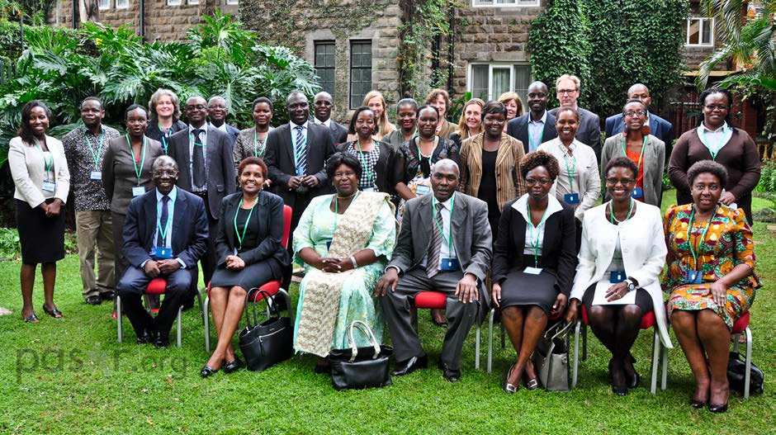
THE CREATION OF UTAFITI SERA TO BRIDGE THE GAP BETWEEN RESEARCH, POLICY AND PRACTICE ON SOCIAL PROTECTION IN KENYA
Groups of people who share interest in SP. Nairobi, MAY 13 2015

Slide 18
MEMBERS OF THE COMMUNITY. UTAFITI SERA FORUM MAY 10, 2016
UTAFITI SERA ON SOCIAL PROTECTION IN KENYA

Slide 19
UTAFITI SERA
Is a ‘vehicle’, ‘house’, ‘forum’ ‘space’ for key stakeholders with interest, power, capacity and motivation to act in diverse ways to ensure that research evidence becomes available and are used to make informed policy decisions and practices.
Aim
Build and sustain a vibrant community of researchers, policy makers and practitioners that will advocate for evidence-based policy uptake
Expected Outcomes
Uptake of research evidence defined as informing & influencing design of new national/sub-national policies & laws, setting agenda for national or sub- national debate, and changing programme design and implementation
19

Slide 20
UTAFITI SERA: Research Policy Community on SP in Kenya
Activities/Inputs
New Research Evidence
Synthesis of existing research evidence
Outputs
Policy Briefs
Video Documentary
Newspaper
Social Media
PASGR, AIHD,INCLUDE, UNICEF, MLEAA, NSSF, NESC, KNBS, NSPS, WB, WFP, HelpAge, Save the Children, APSP, IDS, Country govt, CBOs, Universities, Think Tanks, NGOs, Individuals
Communication Channels
Policy Debate
Meetings
Forums
Advocacy
Short route
Outcomes
New Policies
National debate
Program Design
Implementation changes
Long route
Policy
Influencers/Advocates
www.pasgr.org/utafiti-sera

Slide 21
EXPECTED OUTCOMES OF UTAFITI SERA ON SOCIAL PROTECTION IN KENYA
Legislation on Social Protection
Universalization of Cash Transfer to Senior Citizens and Persons with Disabilities
Exiting/graduation mechanisms of cash transfer
Sustainable Financing of Social Protection Programmes
Effective coordination of social protection programmes
21
21

